Slide 1
Public Meeting Sunday 20th October 2024
Briefing and Discussion
St. Albans Draft Local Plan Section 19 Consultation

Slide 2
Objectives of Meeting
To objectively present the current status of the draft local plan to London Colney residents as it goes through S19 review.
Highlighting the constraints in its development that have had to be negotiated
Highlight the impact on London Colney.
To receive and discuss feedback from residents.

Slide 3
Agenda
Welcome and Introductions - Cllr. Tony Lillico, Chair of LCPC
The Big Picture – Daisy Cooper MP – Member of Parliament for St. Albans
The Approach for St. Albans District – Cllr Paul De Kort, Leader of St. Albans District Council
The Impact on London Colney - Cllr. Tony Lillico, Chair of LCPC
Comments and Questions from councillors and residents

Slide 5
Sites in London Colney (to 2041) 391 Houses over 6 sites (out of 14,603 in district)
Site | Residences
West of London Colney (Shenley Lane) | 324 (Reduced from 405)
East of Morris Recreation Ground (White Horse Lane) | All 53 houses removed from plan
Glebe Allotments (Richardson Close / High Street) | 28
Cotlandswick Garages (2 sites) (Cotlandswick) | 10
Embatool House (High Street) | 21
Berkley House (Barnet Road/Armstrong Close) | 8

Slide 6
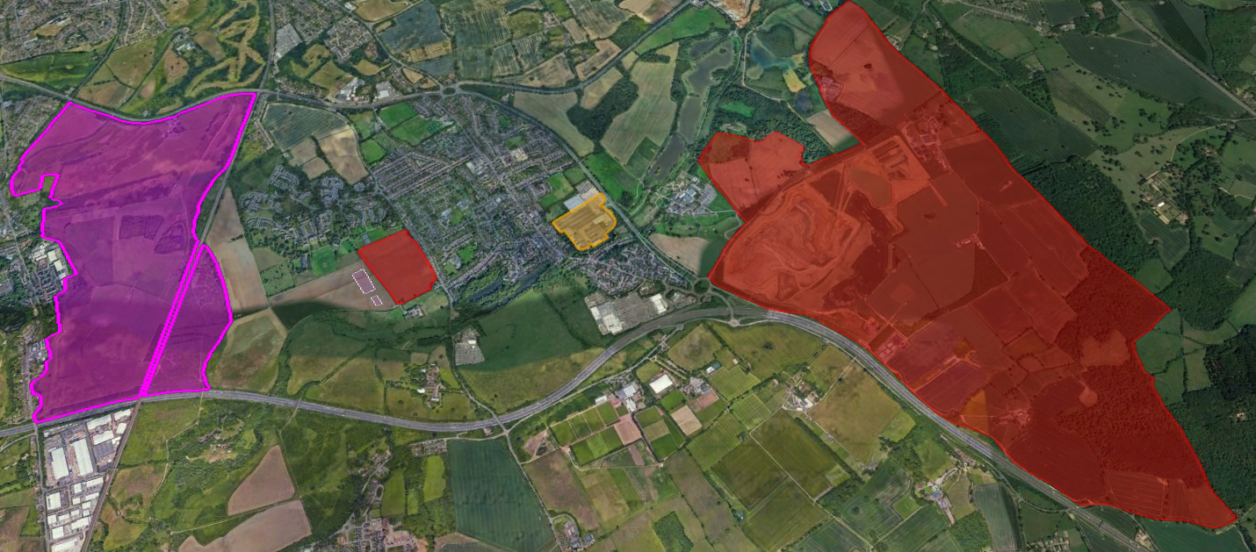
LCPC Concerns - The Pincer Effect
In our response to the S18 SADC draft plan we accepted that land to the south of the Napsbury Estate was the only feasible location for new affordable homes, if it also delivers a secondary school for the village.
We also suggested that the largely derelict Riverside Industrial Estate should be considered as an alternative to building on other green sites in the village.
Freight
Terminal
London Colney
Bowmans Cross
We highlighted our strong opposition to the Freight Terminal and Bowmans Cross settlement on the basis that the sheer scale of the developments will dwarf the village and overwhelm our infrastructure.

Slide 7
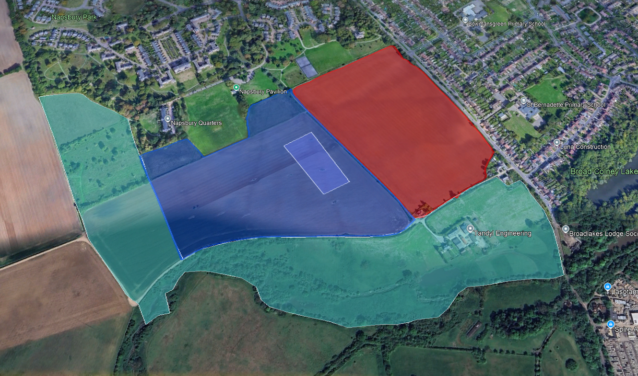
West of London Colney
Red – 324 houses
Blue – school campus
Turquoise – country park
Density reduced following last consultation
405 to 324 houses
Layout extended to include country park and leisure areas.
Access to Napsbury big remaining issue. LCPC strongly oppose any unmanages motor vehicle access.

Slide 8
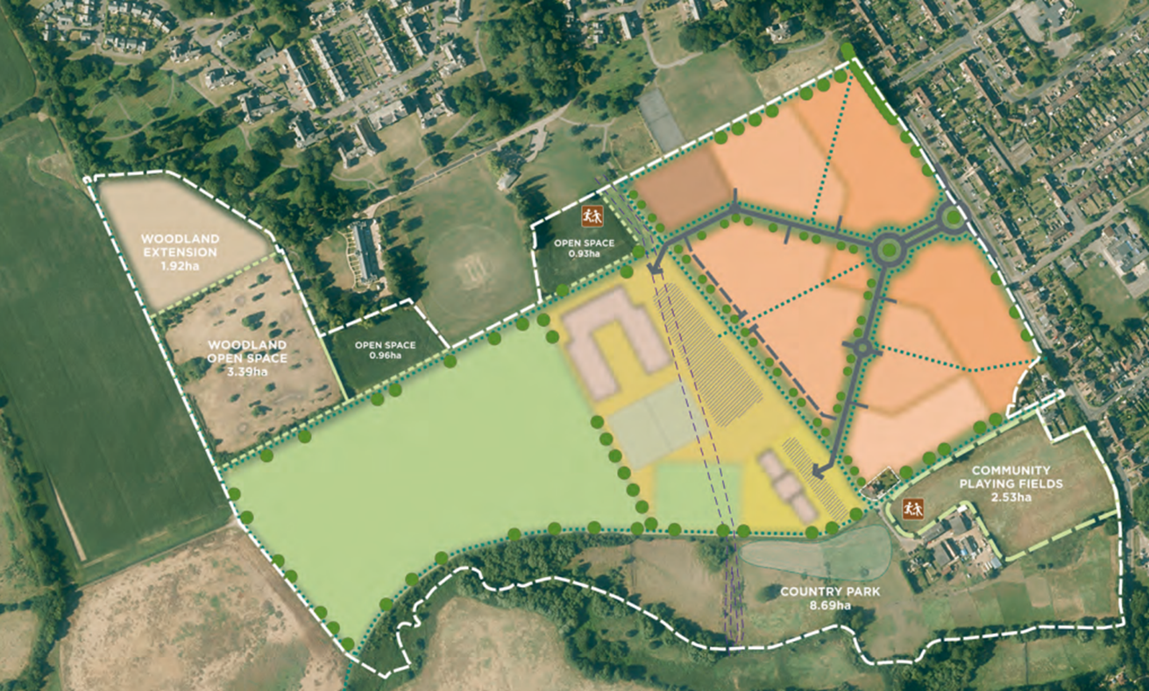
West of London Colney – HCC Proposal
Original submission proposal from HCC included primary school which is no longer part of plan.
Ensuring we get the secondary school and that is scaled appropriately to minimise travel into and out of city is key focus for SADC and LCPC.

Slide 9
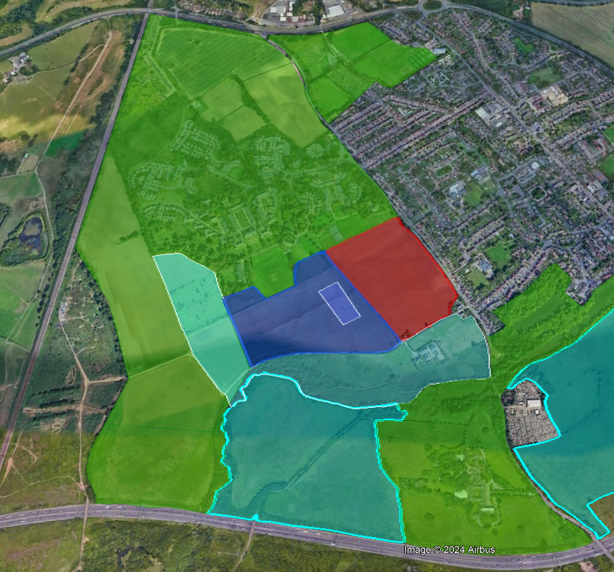
Remaining Green Belt and Country Parks
Having an adopted local plan will ensure speculative applications on green belt around Napsbury will no longer be possible.
But there will be a danger period until the plan is adopted where speculative applications may be passed through by planning inspectors at appeal, due to absence of up-to-date plan and
5-year housing supply.

Slide 10
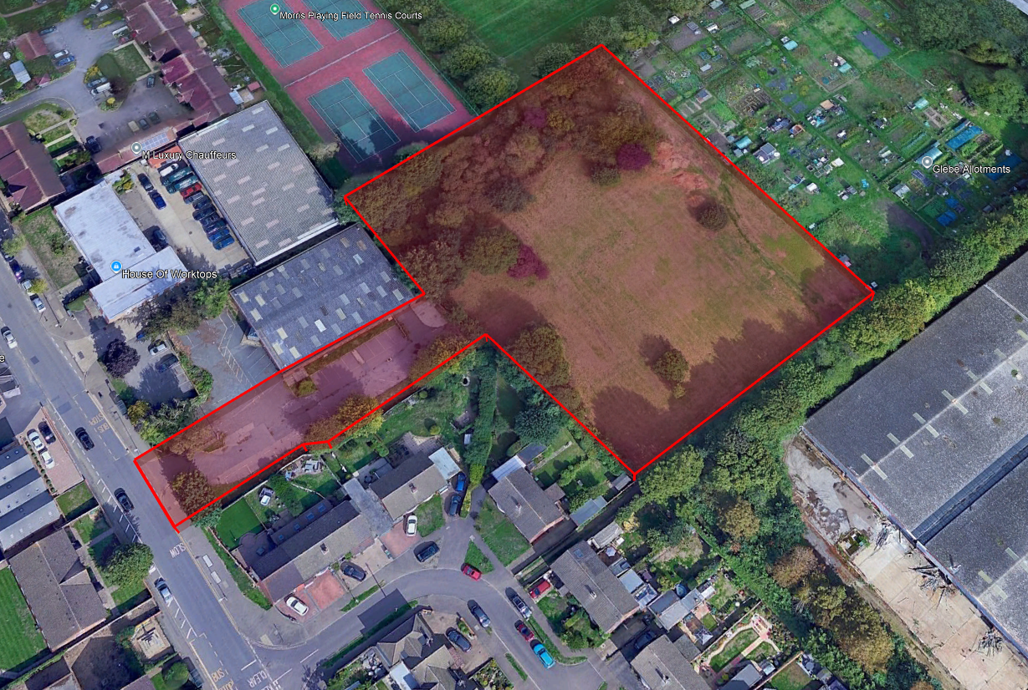
Glebe Allotments
28 houses
This is Church of England land.
Local churchgoers oppose the sale but have no say in decisions made by the church finance team. They need to maximise their investment.
This is technically a brown-field site.

Slide 11
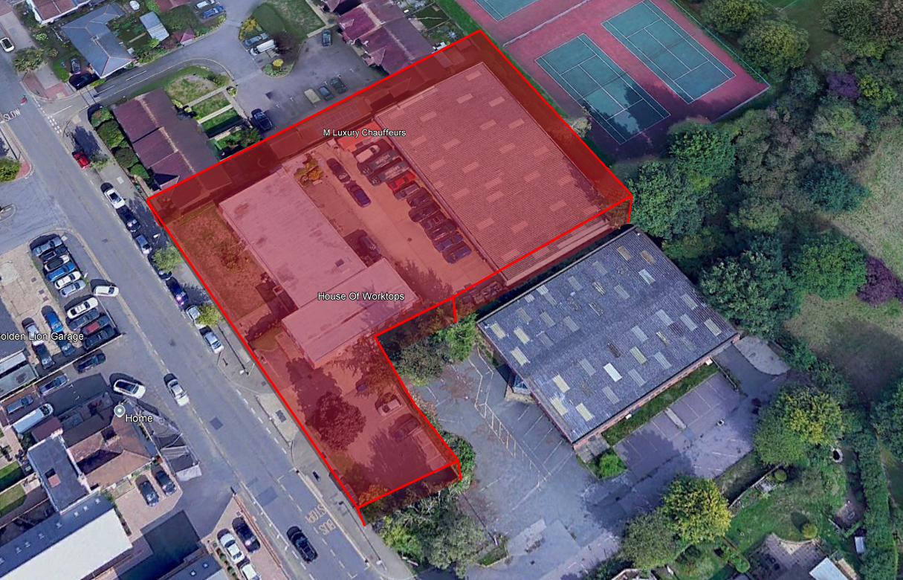
Embatool House
21 houses
Need to preserve and enhance street scene opposite Golden Lion.

Slide 12
Embatool House
21 houses
Need to preserve and enhance street scene opposite Golden Lion.

Slide 13
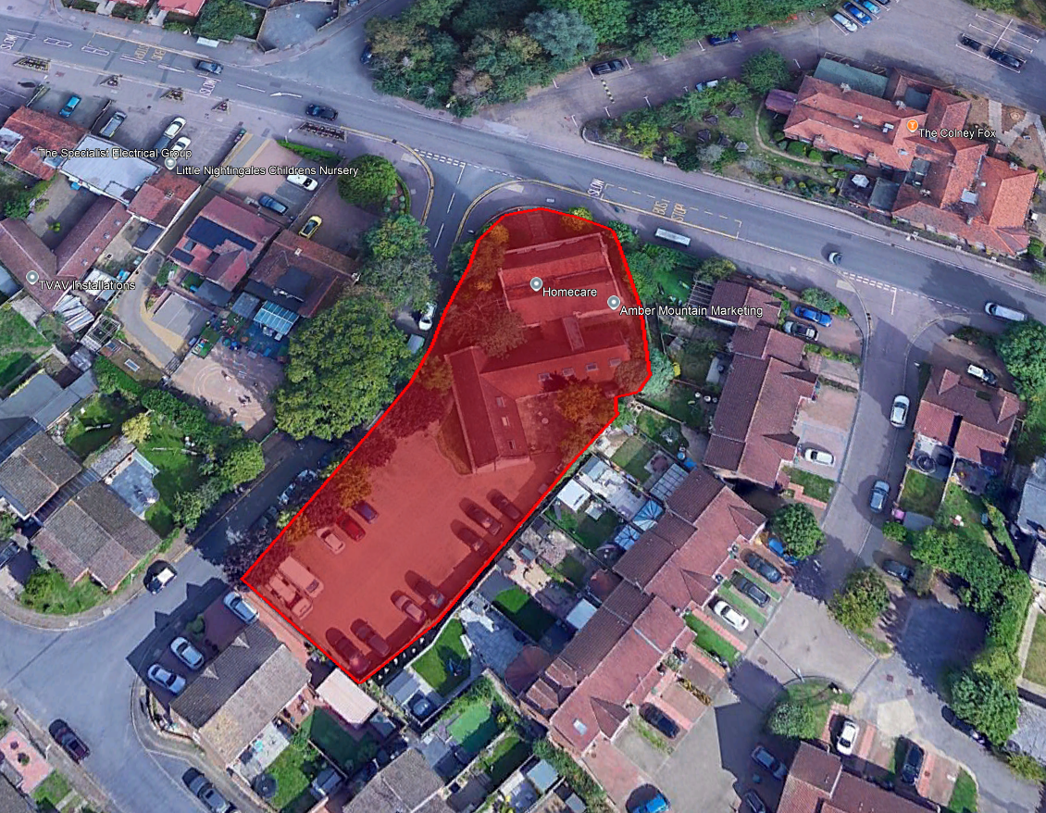
Berkley House (Willowside /Armstrong Close)
21 houses
Within conservation area, so development must enhance setting.
Grade 2 listed building must be preserved and harm minimised.

Slide 14
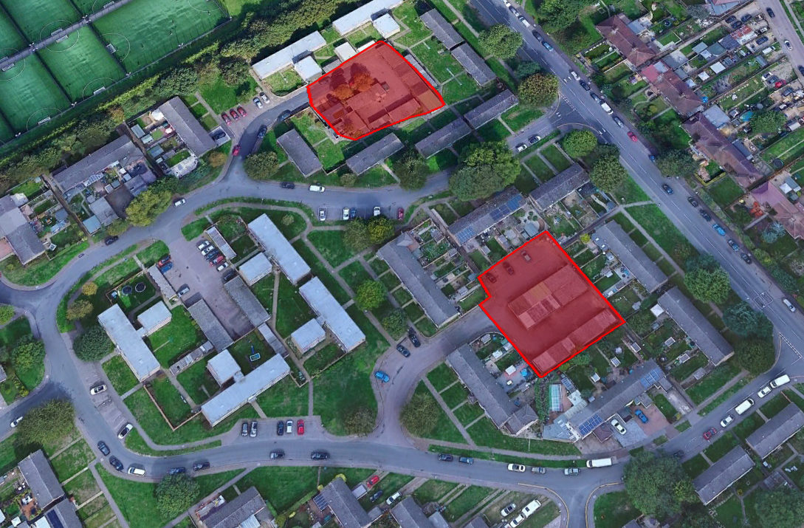
Cotlandswick Garage Sites
Currently sites of ASB, too small for most current cars.
10 homes (indicative). Now spread over 2 sites.
Appropriate levels of parking for existing and new developments must be provided.

Slide 15
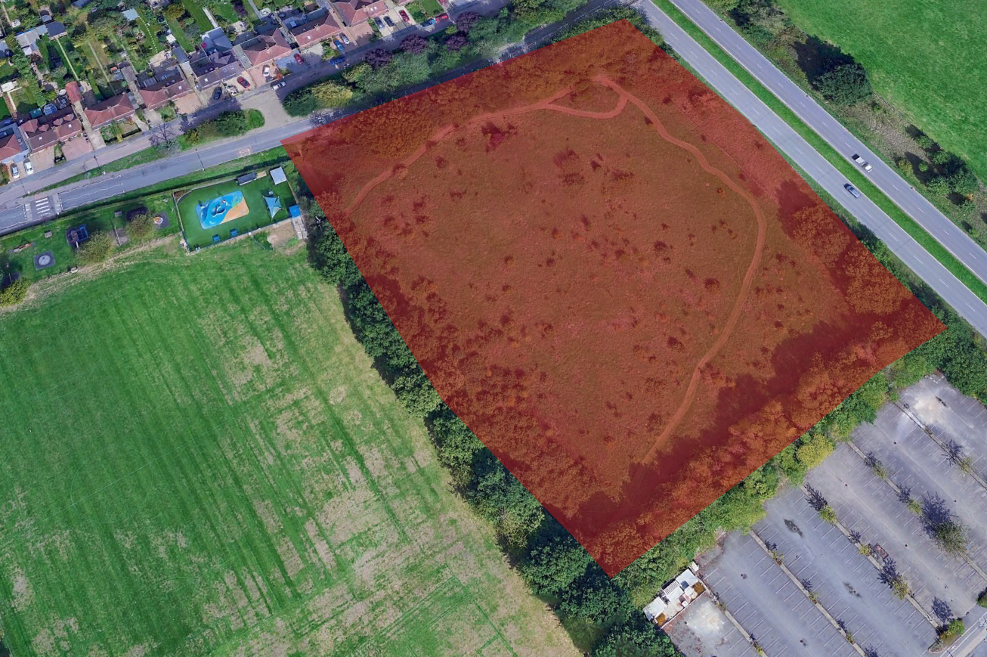
Other Sites 1 – White Horse Lane
Now removed from plan.
Landowners / agents have decided not to renegotiate previous S106 agreement.
Commitment to retain for “recreational purposes” remains.

Slide 16
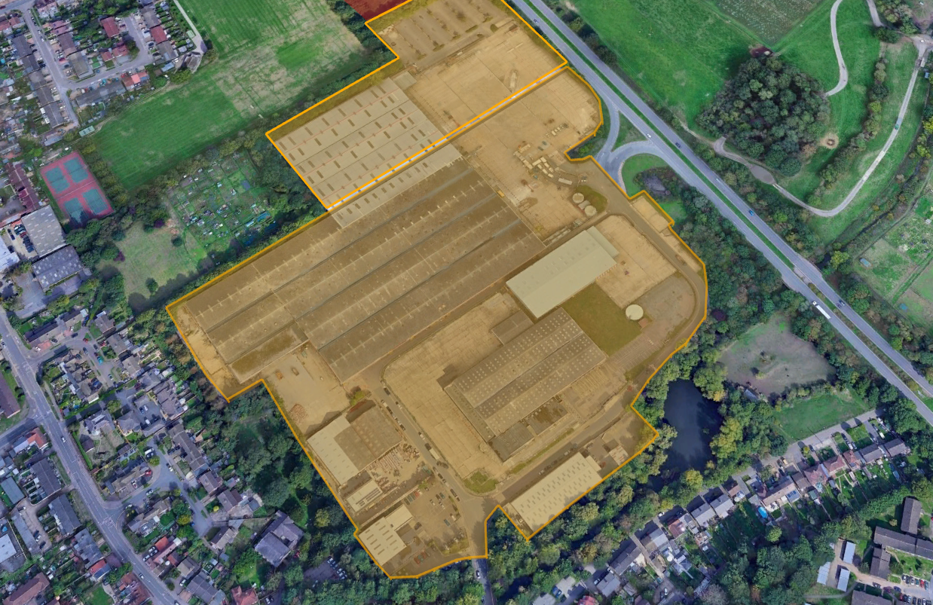
Other Sites 2 – Riverside Industrial Estate
Though mainly derelict planners believe land should be retained for industrial use.

Slide 17
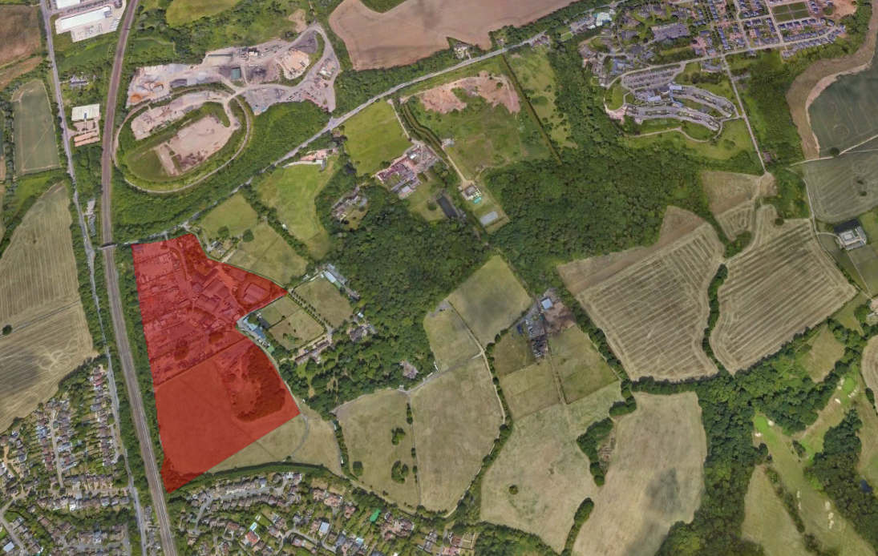
External Sites – Harper Lane
In St. Stephens Parish but will have significant impact on London Colney.
274 new houses
No improvements to bridge over Midland Mainline.
Green belt development
HARPERBURY
TARMAC
RADLETT

Slide 18
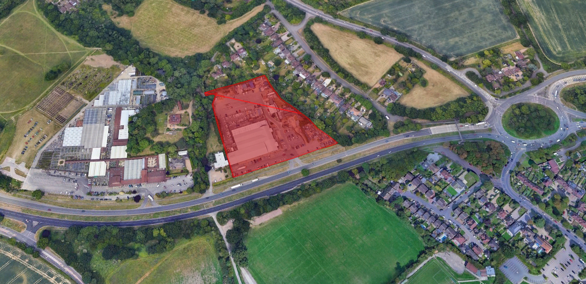
External Sites – North Orbital
64 houses
Covers Herts. Garden Buildings site, also Costa and Wenzels.
Outside of parish but loss of employment locations for London Colney residents.
Concerns about access.
Green (grey) belt development.

Slide 19
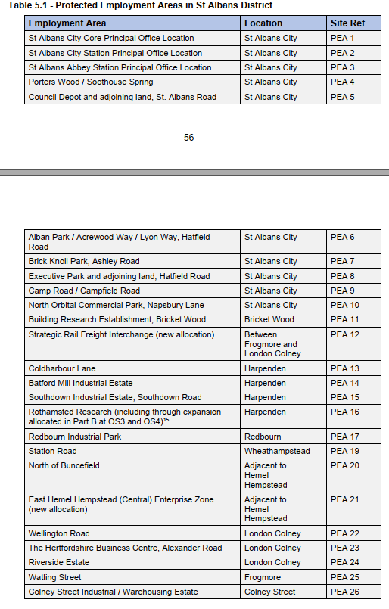
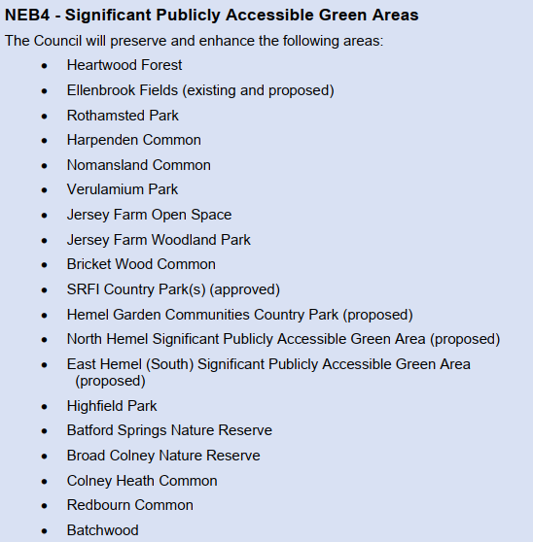
Final Comments

Slide 20
Final Comments
cllr.tony.lillico@londoncolney-pc.gov.uk
07901 922404

Slide 21
BACKUP

Slide 22
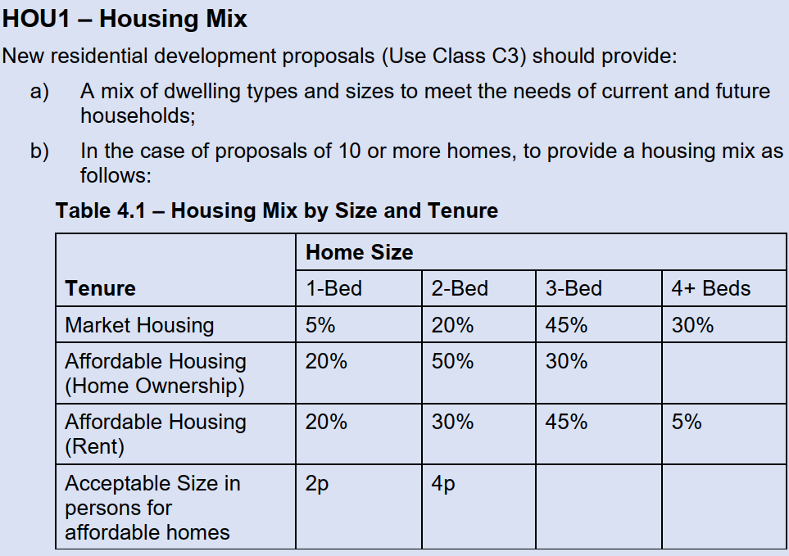

Slide 23
Section 19

Slide 24
Timetable

